Slide 1
Governance within the Executive Boards of associations of the lay faithful
An ecclesial service
AIC Training Reflection
October-November 2023

Slide 2
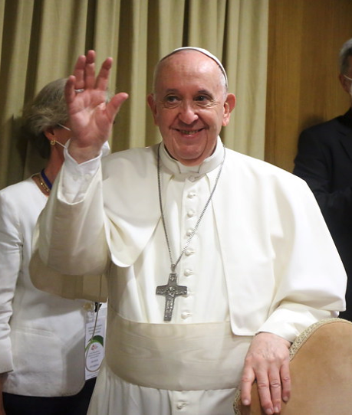
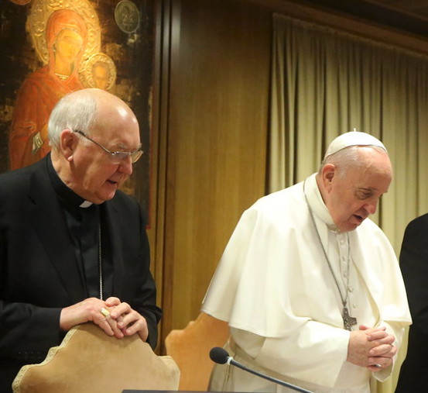
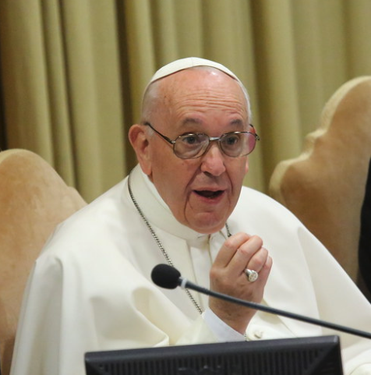
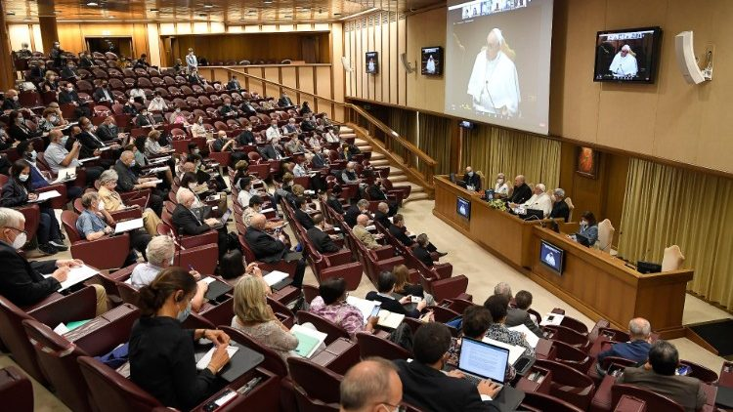
Context
Allegations of abuse of power were brought to the attention of the Dicastery for Laity, Family and Life
June 2021: New General Decree aiming to promote renewal within Executive Boards
September 2021: Symposium “The responsibility of governance within lay associations. An ecclesial service”
An opportunity for reflection within AIC
on the exercise of authority from an
ecclesial perspective
Vatican, 16/09/2021

Slide 3
The ecclesial mission of lay associations
To live out charisms and make them bear fruit
To be a missionary force and a presence of prophecy
To build the future of the holy faithful people of God
To use our gifts to achieve our own objectives and for the good of our members

Slide 4
Governance and the call to serve
Servants of the Lord and of our brothers and sisters
Notion of service:
Service to the person
Service to the charism
Service to the mission

Slide 5
Governance at the service of the charism
Charism = gift inspired by the Holy Spirit
Charism of the founder -> collective charism
Members are co-responsible guardians of the charism, constantly lived out and enlivened -> constant process of maturing
President and Board members = primary servants of the collective charism
The charism should be passed on (prayer, statutes, Jesus at the centre)

Slide 6
Governance at the service of the charism
“Each one, where he or she is placed by the Lord, is called to make [the gifts received for the good of the Church] grow and bear fruit, confident in the fact that it is God who works all things in all people. […] We need to trust in the Holy Spirit, who acts in the life of every association”
– Pope Francis

Slide 7
Obstacles to good governance:
The desire for power
Disloyalty

Slide 8
Governance and the exercise of authority in the Church
Authority allows the community to grow
Need for constant discernment and an ability to take a step back
A balance should be kept between excessive authority and lack of authority
Tensions are sometimes inevitable -> they should be managed with discernment, in keeping with our ecclesial mission

Slide 9
Governance and the invitation to accept change
In order to improve
Reflecting together in order to incarnate the charism in new situations
Providing for a rotation in posts of governance
In order to prepare for the future
Learning to listen and to discern, and being willing to engage in a constant encounter with the Lord and a personal conversion

Slide 10
Governance and term limits
To promote a healthy renewal of governing bodies
To prevent appropriations that have given rise to violations and abuses in the past
Changes to the AIC Constitution in order to comply with certain new requirements

Slide 11
CONCLUSION
We plant the seeds of what will develop when we are no longer around…
It is important to learn to withdraw and to encourage the renewal of teams
It is necessary to provide training on governance as an ecclesial service to all AIC volunteers, taking into account the reality of today’s Church:
-> so that we can give volunteers responsibilities later
-> so that volunteers contribute to setting up a good Executive Board
We are all invited to put into practice and pass on the spirit
of the General Decree at all levels of the association!

Slide 12
CONCLUSION
Our mission as Executive Board
= to prepare for the future

Slide 13
As lay people, we have a crucial role within the Church!
“The work done by lay people is enormous, especially since Vatican II”
“Without lay people, there would be no Church today! They are the ones who make it progress, who drive forward the development of social and educational programmes”
Cardinal Farrell,
Prefect of the Dicastery for Laity, Family and Life,
Vatican, 16th September 2021

Slide 14
Questions to discuss in your groups
What caught your attention the most?
What are the main challenges related to governance in your group/association?
What training in good governance do you offer to your association’s volunteers?

Slide 15
Questions to discuss in your groups
How can we ensure that employees of AIC associations work in decent conditions? If necessary, what can we do to improve their working conditions?
What more could we do to spread the spirit of the General Decree within our association and encourage the renewal of leaders within our teams as requested by the Dicastery?

